Slide 1




Blood Group Detection Using InfraRed Image and Machine Learning
DEPARTMENT OF ELECTRONICS AND COMMUNICATION ENGINEERING
June, 2022-26
INDIAN INSTITUTE OF INFORMATION TECHNOLOGY SURAT-394190
Roll No.: UI22EC58 (Rahul Patel)
Under the guidance of
Mr. Rahul Patel

Slide 2

CONTENTS
1. Problem Statement
2. Objective
3. Proposed Solution
4. Market Research & Validation
5. Target Market
6. Competitive Analysis
7. Business Model
8. Logo & Tagline Redesign
9. Dataset Overview
10. Preprocessing Steps
11. Model Architecture
12. Training Parameters
13. Evaluation Metrics
14. Confusion Matrix
15. MVP – Web Application Demo
16. Go-To-Market Strategy
17. Uniqueness & Innovation
18. Future Roadmap
19. Conclusion & Final Ask

Slide 3


1. Problem Statement
Manual blood group detection is time-consuming, error-prone, and inaccessible in remote areas.
1
Significance
Faster blood group identification is crucial in emergency and medical scenarios.
2
Benefits
High demand for rapid, reliable, and automated solutions.
Reduces human errors and improves the accuracy of blood group testing.

Slide 4
Abstract
This project focuses on automating blood group detection using spectroscopic images. Our approach utilizes a Machine learning model based on the VGG16 architecture, specifically fine-tuned for this classification task. This model has achieved a high accuracy of 87.34%, demonstrating its potential for efficient and reliable blood group determination. We have also developed a user-friendly web application that allows for easy integration into various medical settings.
Objective
Approach
Results
Develop an automated system for blood group detection using image analysis and Machine learning.
Employ a Machine learning model based on VGG16 architecture, fine-tuned for 8-class blood group classification.
Achieved a 87.34% accuracy on the test dataset and developed a user-friendly web application for real-time predictions.

Slide 5

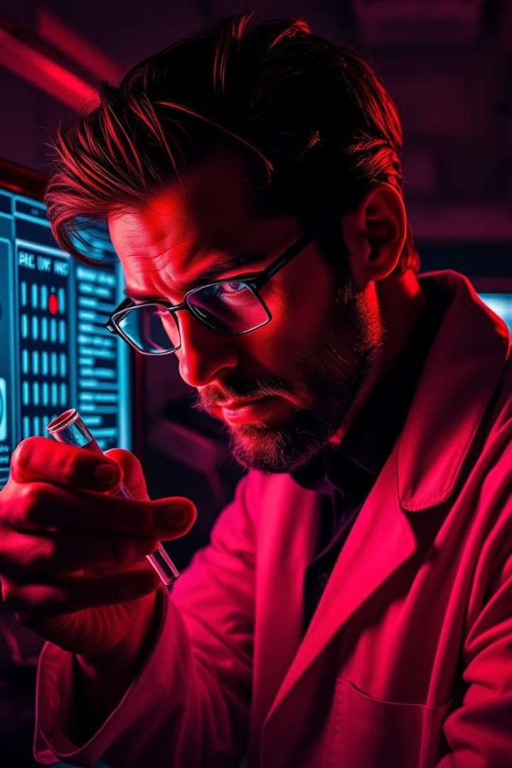
2. Objective
To develop an automated blood group detection system using spectroscopic images and machine learning.
Improve speed, reliability, and accessibility.
This project explores the use of machine learning to automate blood group detection using spectroscopic image processing. The goal is to develop a system that can accurately predict blood groups from images, leading to faster and more reliable blood group identification.

Slide 6
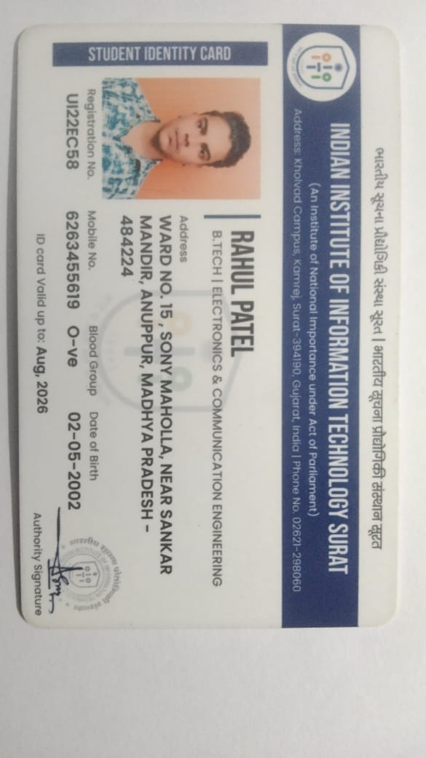
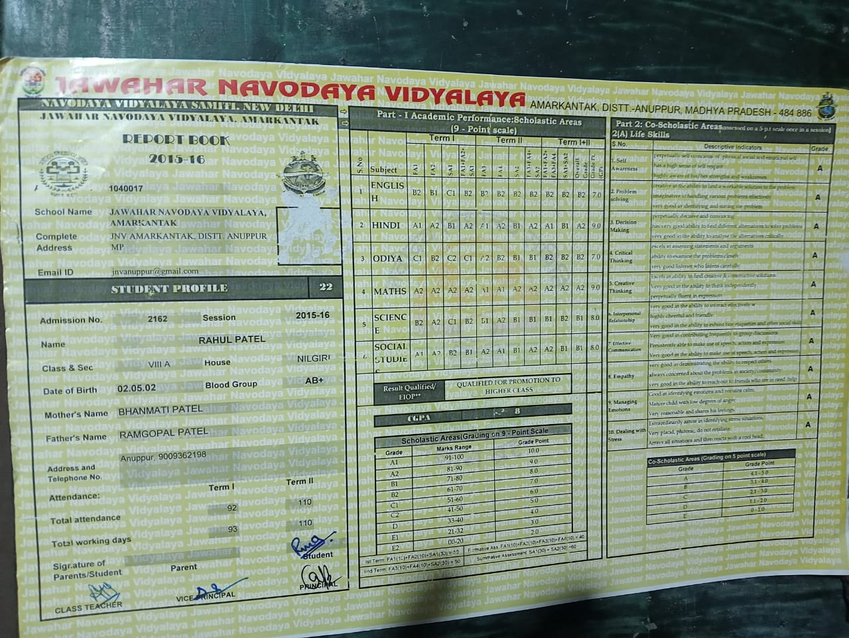
Traditional Method Error (Not 100% Accuracy)
Class | Blood Group
8th | AB+
After 8th | O-

Slide 7


3. Proposed Solution
VGG16-based ML model trained on spectroscopic images
Flask-based web app for real-time detection
87.34% test accuracy

Slide 8
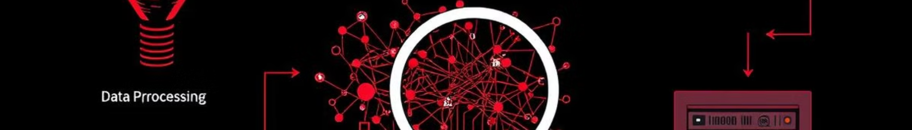
Methodology
The methodology involves a series of steps, starting with data Preprocessing , followed by model architecture, evaluation, and finally, deployment. Each step plays a crucial role in building a robust and accurate system for automated blood group detection.
Data Preprocessing
1
Image resizing, augmentation, and splitting into training, validation, and test sets.
2
Model Architecture
Utilization of a pretrained VGG16 network, fine-tuned for 8-class classification, with custom dense layers and softmax activation.
Evaluation
3
Assessment of model performance using metrics such as accuracy, confusion matrix, and loss.
4
Deployment
Implementation of a Flask-based web application for real-time blood group predictions.

Slide 9


4. Market Research & Validation
118M blood donations per year globally (WHO)
Hospitals and emergency services need faster diagnostics
Online survey: 86% doctors support AI-aided diagnostics
5. Target Market
Hospitals & Blood Banks
Emergency Services
Remote Clinics
Military & Disaster Teams
Medical Research Labs

Slide 10

6. Competitive Analysis
Method | Time | Accuracy | Portability | Human Error
Traditional Lab | High | High | Low | High
BioVision (ML) | Low | High | High | Low

Slide 11
7. Business Model
💰 Revenue Streams (How We Earn)
# | Revenue Stream | Model | Estimated Revenue (Annual)
1 | B2B Licensing to Hospitals | ₹1,50,000/year per hospital; target 10 hospitals in year 1 | ₹15,00,000
2 | Subscription for Research Labs | ₹3,000/month per lab; targeting 20 labs | ₹7,20,000
3 | Freemium Web App (Premium Users) | ₹499/month per premium user; assume 1,000 paid users | ₹59,88,000
4 | Infrared Imaging Device (Hardware) | ₹15,000/device; expected sale of 500 devices/year | ₹75,00,000
 | Total Potential Revenue (Year 1) |  | ₹1,57,08,000

Slide 12
💸 Cost Structure (Where We Spend)
Category | Description | Estimated Annual Cost
Cloud Hosting | AWS/GCP server usage, storage, and bandwidth for API and web deployment | ₹2,00,000
Model Maintenance & Updates | Developer salaries (part-time), dataset cleaning, retraining, bug fixes | ₹4,00,000
Customer Support & Management | Handling client issues, onboarding support, and technical documentation | ₹1,00,000
Hardware Manufacturing (IR device) | Manufacturing cost per unit (₹8,000 x 500 units) | ₹40,00,000
Marketing & Branding | Digital ads, conference demos, branding materials (posters, logos, social media) | ₹2,50,000
Legal & Compliance | Licensing, data privacy compliance (e.g., HIPAA equivalent), consulting fees | ₹1,00,000
 | Total Estimated Cost (Year 1) | 50
📊 Projected Year-1 Profit:
Revenue (₹1,57,08,000) – Cost (₹50,50,000) = ₹1,06,58,000

Slide 13




9. Dataset Overview
Source: Kaggle
Classes: A+, A-, AB+, AB-, B+, B-, O+
Samples: Train (46), Validation (14), Test (11)
Dataset Overview | Details
Number of Classes | 7(A+, A-, AB+, AB-, B+,B-,O+)
Training Samples | 46
Validation Samples | 14
Test Samples | 11

Slide 14
9. Updated Dataset Overview
Source: Kaggle+Synthetic data
Classes: A+, A-, AB+, AB-, B+, B-, O+,O-
Samples: Train (2800), Validation (600), Test (600)
Dataset Overview | Details
Number of Classes | 8(A+, A-, AB+, AB-, B+,B-,O+,O-)
Training Samples | 2800
Validation Samples | 600
Test Samples | 600

Slide 15
✅ Dataset Size: 500*8= 4000
✅ Split : 70% Train, 15% Validation, 15% Test
Set | Images per class | Total images
Train | 350 | 2800
Validation | 75 | 600
Test | 75 | 600

Slide 16
Subset Classification Based on Temperature Range
Subset Category | Temperature Range (°C) | Description
Low | Below 36°C | Indicates cooler blood sample images
Normal | 36°C – 37.5°C | Represents typical physiological conditions
High | Above 37.5°C | Simulates fever or heated sample conditions

Slide 17
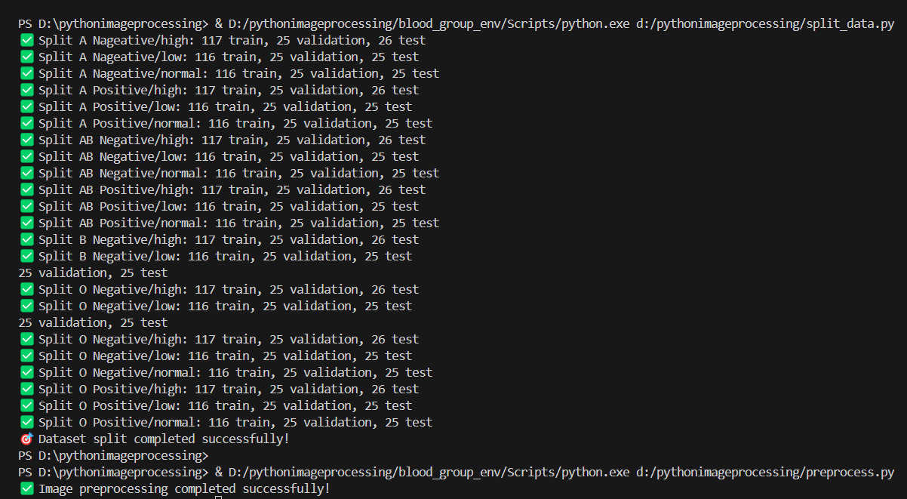

Slide 18

10. Preprocessing Steps
1
Normalization
Images are normalized to a common scale for consistent processing.
2
Resizing
Images are resized to a uniform size for model input.
3
Data Augmentation
Techniques like rotation and zoom are applied to increase dataset diversity.

Slide 19


11. Model Architecture
Base: Pretrained VGG16
Custom Layers: GlobalAveragePooling2D, Dense, Softmax
Classification: blood group classes

Slide 20


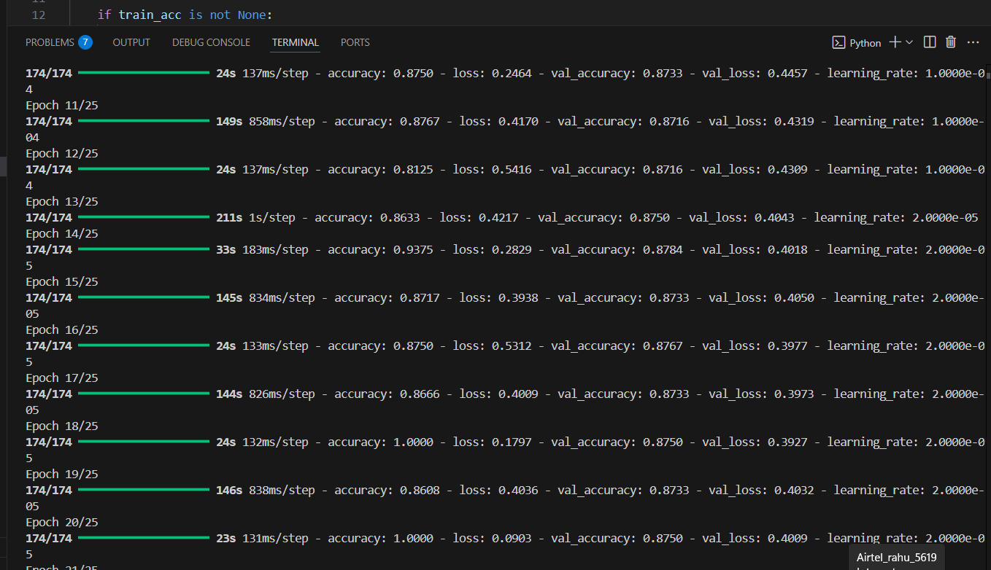
12. Training Parameters
1
Epochs: 25
2
Batch Size: 16
3
Loss Function: Categorical CrossEntropy (Loss: 0.39)
Output Screenshot

Slide 21
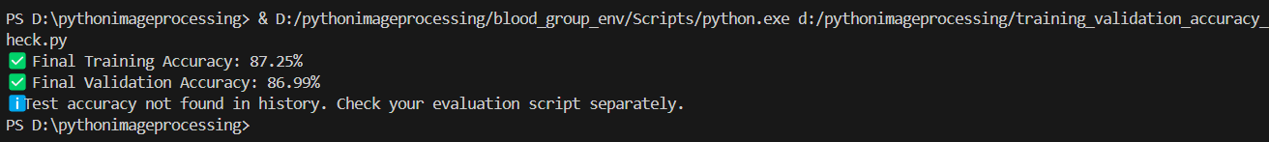
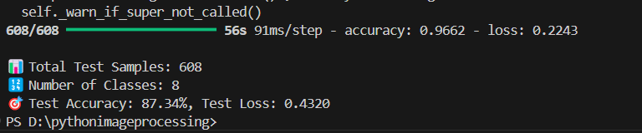

Slide 22





13. Evaluation Metrics
Training Accuracy: 87.36%
Validation Accuracy: 86.83%
Test Accuracy:
87.34%
Metrics Used: Accuracy, Precision, Recall, F1 Score

Slide 23

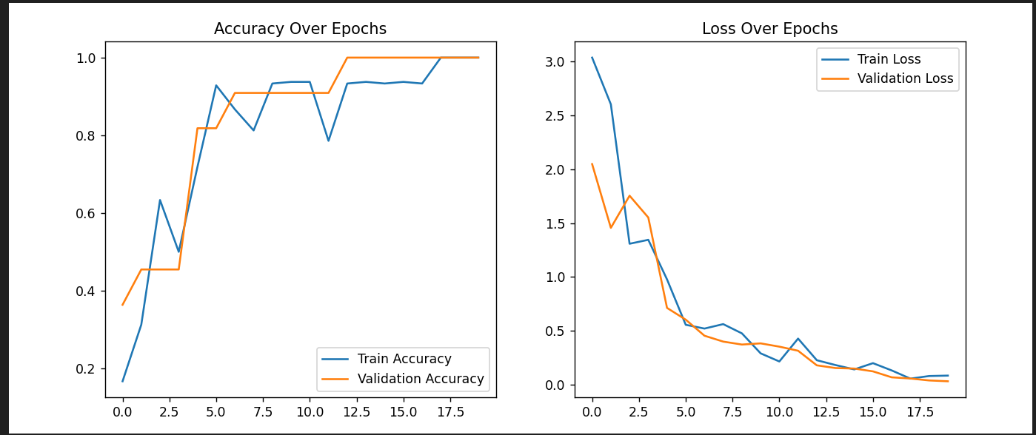
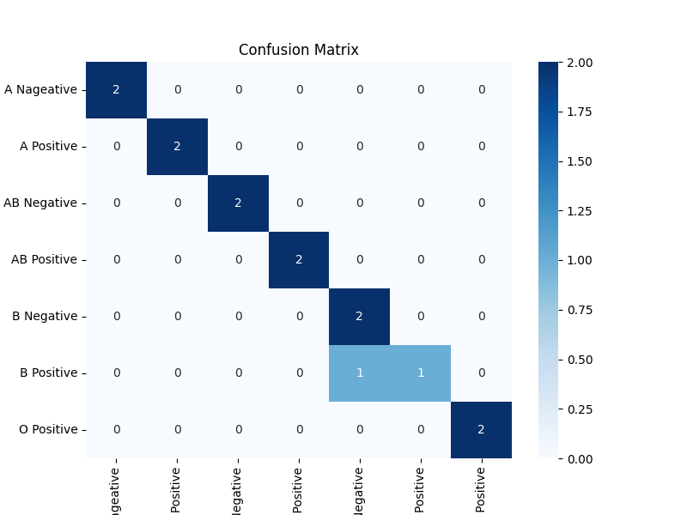
14. Confusion Matrix

Slide 24
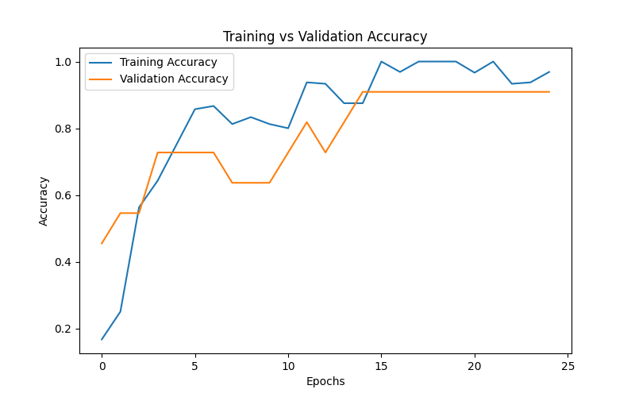
14. Updated Confusion Matrix

Slide 25
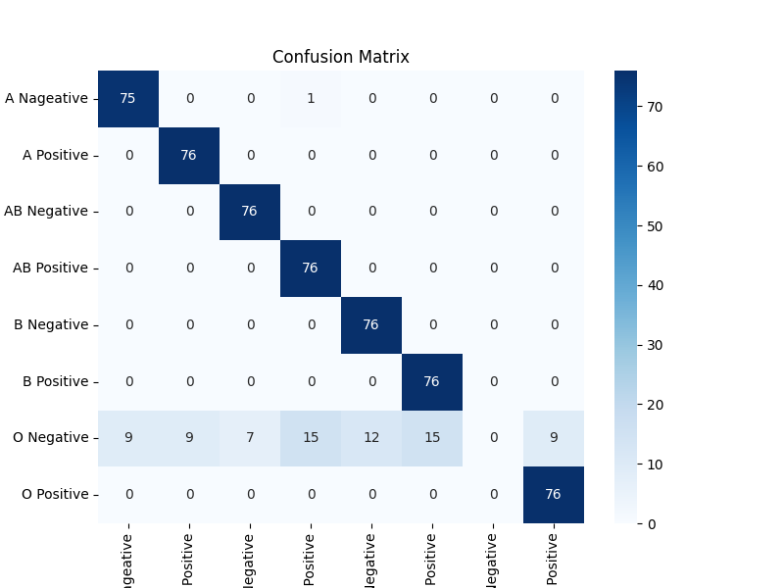

Slide 26

15. MVP – Web Application Demo
1
Flask-based app for real-time predictions
2
Upload image and Temp.→ Get result
3
Demo screenshots / small GIF preview

Slide 27
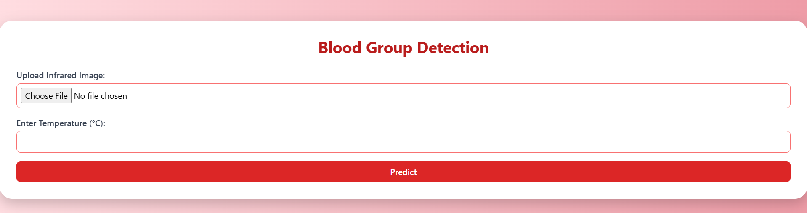
User Interface

Slide 28
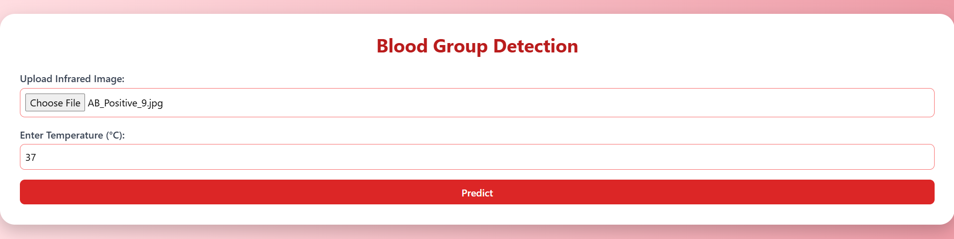

Slide 29
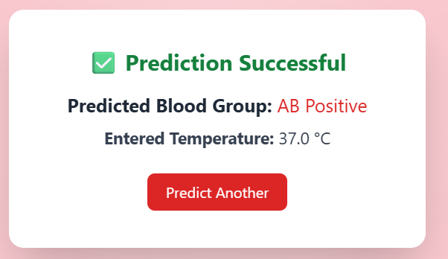

Slide 30
16. Go-To-Market Strategy
Target hospitals, labs, and researchers.
Promote via SEO, social media, and email outreach.
Offer freemium web app to drive adoption.
Partner with med-tech firms and hospital IT providers.
Attend medical expos and tech conferences.
Share tutorials and case studies online.
Gather feedback to improve and retain users.

Slide 31
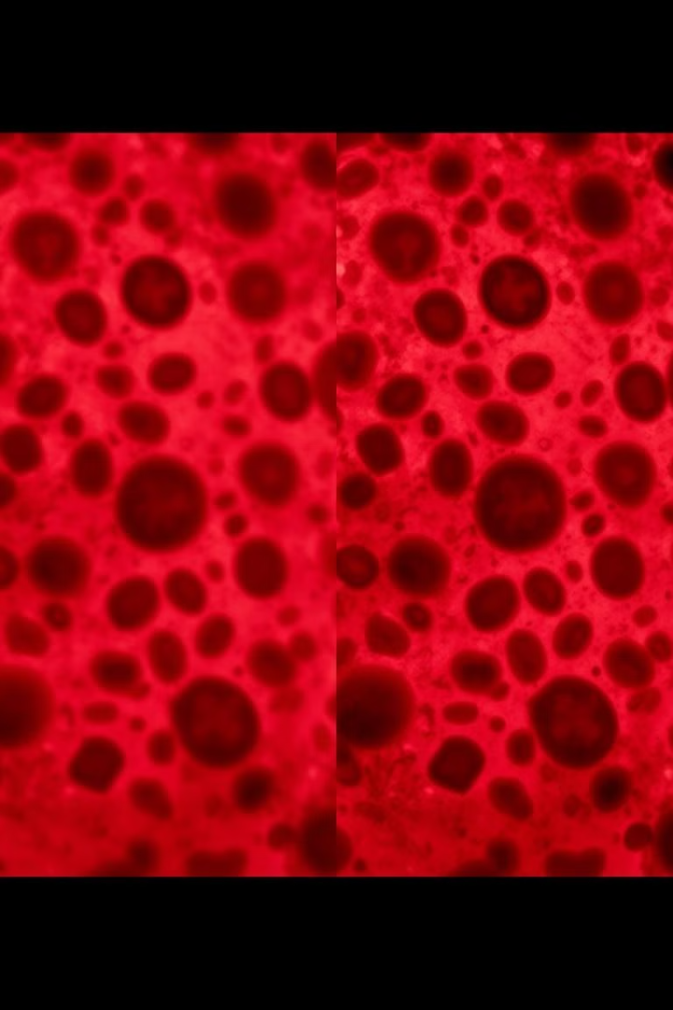
17. Uniqueness & Innovation
1
InfraRed Spectroscopic Imaging (vs. traditional agglutination)
2
ML-Powered Prediction – 87.34% accurate
3
Portable, Real-time Web App
4
No skilled personnel needed

Slide 32





18. Future Roadmap
Add O-, rare blood groups
Deploy as mobile app
Integrate with hospital databases
Hardware prototype with IR camera

Slide 33



19. Conclusion & Final Ask
Successfully built an ML system with 87.34% test accuracy
Real-time web interface ready
Support for field testing, scaling, mentorship, and funding

Slide 34
